Slide 1
Linux on
Network Switch and Management
Hyung-Soo Kim - Tetration CSE - Cisco Systems, Inc

Slide 2
Agenda
Linux on Network Switches
Introduction to NETCONF
Introduction to RESTCONF
Useful information

Slide 3
Linux on Network Switch
Notes:
Our philosophy: it’s your switch, you bought it, you should be able to do whatever you want with it. Extend its capabilities via Linux.

Slide 4
Open NX-OS Linux
Kernel 3.4
  64bit Linux 3.4 kernel
Kernel Stack
  Move from custom-built userspace stack(NetStack) to Native Linux Networking Stack
  Physical, port-channel, vPC, VLAN and logical interface mapped to Kernel
  VRF mapped to Linux namespace
Open Package Management
  Support RPM & custom-developed software installation
Container Support
  Centos 7 based LXC support named GuestShell

Slide 5
Benefit from Linux Kernel Stack
Linux utilities for interface management
  ifconfig, ip, ethtool
Linux tools for troubleshooting
  Leverage tools like tcpdump, ping and traceroutes
VRF capabilities with Namespace
  Same name from VRF creation mapped to Namespace
Linux socket communication
  Custom-developed application use standard Linux socket

Slide 6
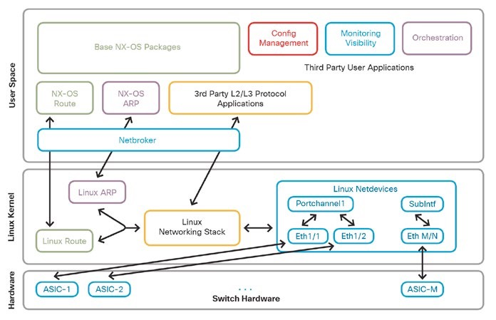
Architecture of Open NXOS

Slide 7
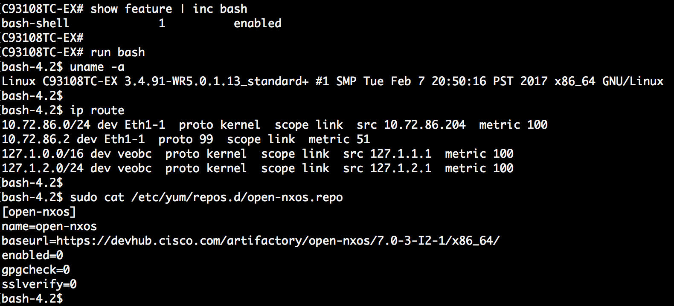
Native Bash-Shell

Slide 8
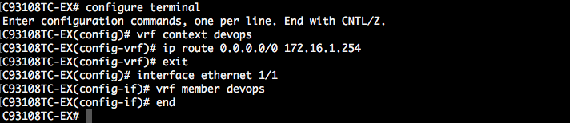

VRF and Linux Namespace (1/2)

Slide 9
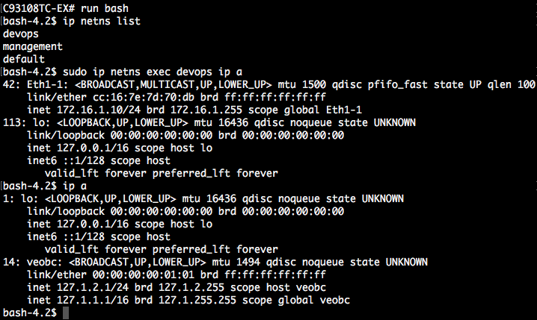
VRF and Linux Namespace (2/2)

Slide 10







Guest Shell
3rd Party
Apps
It’s an open Linux environment, decoupled from NX-OS.
64-bit CentOS 7.
DevOps
NX-OS CLI
GUEST SHELL
Apps
Apps
Apps
bootflash:
Python enabled CentOS 7.0 rootfs
Open Source Packages
Cisco Packages
Secure Linux Container (sLXC)
N9K / N3K
Notes:
Linux is foundation of Nexus 9K. NX-OS is actually a set of Linux process running on top of the Linux kernel.
We provide access to Linux on N9K via the Guest Shell. It’s a container that is running CentOS 7. It’s decoupled from NX-OS.

Slide 11
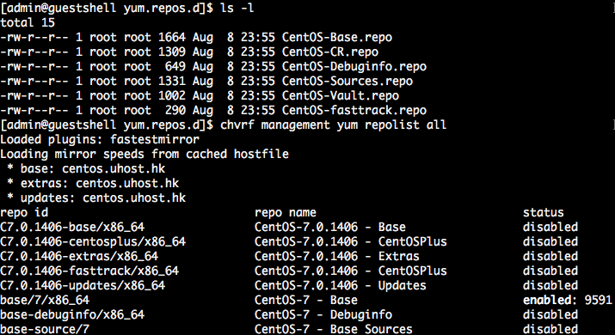
Richly Populated Repositories for 3rd Party Apps
chvrf utility used to select VRF ( i.e. network namespace)
Notes:
This is how to enter the Guest Shell. From there, there’s no difference with a container running on a Linux server.
We chose CentOS 7 distribution because it’s widely deployed. So there’s a lot of Linux packages already. Here can see that the default yum repositories are in place. It gives us 9000 packages available by default.

Slide 12
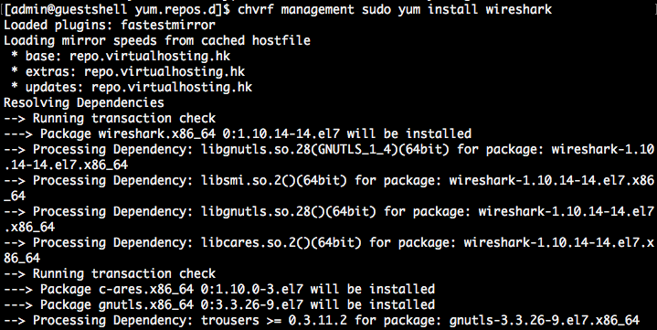
Install 3rd party package via YUM

Slide 13
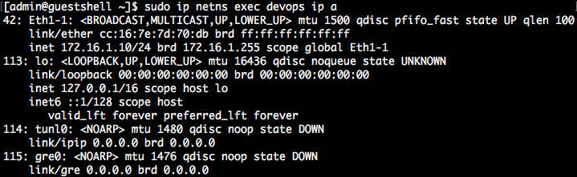
Linux Networking Is Possible From the Guest Shell
Only read access is allowed from the guest shell.
For write access (interface configuration)
1) use the native shell.
2) use dohost utility
Notes:
This means we can support any 3rd party application which relies on networking data from Linux. …
Read access only for security reasons. For write access, use the native shell. It’s not a container, it’s a shell of the actual Linux that runs the switch. Unless you really need to, we recommend that you don’t use the native shell and use the guest shell instead, for security reasons.

Slide 14
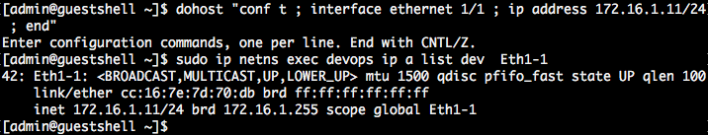
Use dohost utility
# dohost “CLI command for configuration “

Slide 15
The Guest Shell is Secure
Namespaces are separate, resource usage is controlled, access is controlled.
No visibility into Cisco proprietary software (cannot read, write, or execute NX-OS binaries).
No visibility into Cisco proprietary disk partitions.
No access to internal, Cisco proprietary drivers.
No ability to load kernel drivers.
Notes:
Safe environment: Namespace separation, resource usage is controlled, access is controlled
No visibility into Cisco proprietary software (cannot read, write, or execute NXOS binaries). This is of no value to an application developer unless he has access to Cisco proprietary code base.
No visibility into Cisco proprietary disk partitions.
No ability to view, start and stop Cisco proprietary processes. This is of no value an application developer. Cisco software may have complex interdependencies that can change from release to release.
No access to internal, Cisco proprietary drivers. This is of no value to application developer unless he has access to Cisco source code and understands software interdependencies.
No ability to load kernel drivers. Kernel drivers are highly dependent on Kernel version of a specific release. For Linux user space application development, there is no need to export this capability.

Slide 16
Linux Apps Can Interact With the External World
Nexus 9K
Your Custom Applications
(Python, C++ etc.)
Existing 3rd Party Linux Applications
Linux Networking Stack
Linux - Guest Shell
NX-OS
CLI
L2
L3
Interfaces
Platform
Etc

Slide 17
Guest Shell Use Cases
Monitoring
  3rd party tools: OpenTSDB, Ganglia, Nagios, etc.
  Monitoring both standard Linux items (CPU, memory, interface counters) and NX-OS (buffers, routes...)
  Custom-made (example: PTP monitoring of a specific offset threshold, Grandmaster change)
Extensibility
  IDS
  DNSFlow
Managability
  Chef / Puppet Agents
  Automatic config backup to Git
  Use the switch as a PXE server
Troubleshooting
  Tcpdump
Notes:
3rd party monitoring is especially useful when it’s monitoring the servers as well.

Slide 18
Introduction to
Standard Device Interfaces

Slide 19
The Network is No Longer Isolated
Notes:
Network Engineers leveraging CLI are no longer the only parties and methods interested in configuring and monitoring the network.
DevOps as an approach to development and operations has proven successful for many organizations, and these teams are quickly looking at how they can expand their reach into the network.
New Web Applications leveraging Micro-Service architectures are building overlay container networks, but as the model matures, these applications look to integration with the underlying network for performance and segmentation.
And the "Cloud" is no longer a destination, but rather a complete approach to delivering IT Services and Applications. This approach demands fully programmatic (ie through APIs) access to services. Consumers aren't interested in individual devices and feature configuraiton, but rather the capabilites that the network can provide.

Slide 20
What about SNMP?
SNMP works “reasonably well for device monitoring”
RFC 3535: Overview of the 2002 IAB Network Management Workshop – 2003
https://tools.ietf.org/html/rfc3535
Typical config: SNMPv2 read-only community strings
Typical usage: interface statistics queries and traps
Empirical Observation: SNMP is not used for configuration
  Lack of Writeable MIBs
  Security Concerns
  Difficult to Replay/Rollback
  Special Applications
Notes:
Needing an alternative to CLI for configuration and management isn't a new requirement. SNMPv1 was originally proposed in 1988 (RFC 1098 in 1990 when it was just called SNMP). It was designed to provide a standard interface for network management systems to configure and retrieve monitoring information.
Over time SNMP has been updated several times bringing in SNMPv2 and SNMPv3. These updates targeted increasing performance and security among other topics. However...

Slide 21
RFC 3535: What is Needed?
A programmatic interface for device configuration
Separation of Configuration and State Data
Ability to configure "services" NOT "devices"
Integrated error checking and recovery
Notes:
Working groups within the IETF approached the need for a new standard programmatic interface for Network Configuration. This isn't to say that individual vendors haven't worked to address the need individually. Many vendors, including Cisco, saw the need and began offering new APIs leveraging interfaces models such as:
- SOAP
- REST
- JSON-RPC
- XML
However, most customers, partners, software developers, and even vendors agree that having a Standard Device Interface approach is better than disparate proprietary ones. This isn't a new concept in networking, that's how many of the most widely adopted technologies began.

Slide 22
NETCONF / YANG (RESTCONF & gRPC)
NETCONF – 2006 – RFC 4741
(RFC 6241 in 2011)
YANG – 2010 – RFC 6020
RESTCONF – 2017 – RFC 8040
gRPC – 2015 – OpenSource project by Google
Notes:
Building on RFC 3535, the IETF developed NETCONF and YANG to offer a standard protocol and data modeling language for programmatic network management.
NETCONF was originally proposed in RFC 4741 in 2006, and YANG in RFC 6020 in 2010. Both are new technologies that continue to evolve and gain acceptance from customers and vendors.
While the NETCONF protocol provides a programmatic interface tackling many of the challenges of SNMP, as developers have begun leveraging it there has been interest in providing interface options that align closer with REST APIs and other programmatic standards. RESTCONF and gRPC are alternative protocols to NETCONF that look to address some of these goals.
RESTCONF achieved standardization in January 2017 with RFC 8040.
gRPC is an OpenSource project begun by Google to provide a modern RPC framework that can be used in any environment for multiple purposes, not just network configuration. Details can be found at grpc.io.
Though all the technologies are rapidly being adopted by many vendors and organizations, NETCONF and YANG are the most widely available Standard Interfaces on networking devices today, and having a solid understanding of their use and implementation is the best place to start. And that will be the focus of this module.

Slide 23
Introduction to
YANG Data Models

Slide 24
Three Meanings of “YANG”
YANG Modeling Language
YANG Data Models
YANG Device Data

Slide 25
Where do Models Come From?
Industry Standard
Vendor Specific
Standard definition
(IETF, ITU, OpenConfig, etc.)
Compliant with standard
ietf-diffserv-policy.yang
ietf-diffserv-classifer.yang
ietf-diffserv-target.yang
Vendor definition
(i.e. Cisco)
Unique to Vendor Platforms
cisco-memory-stats.yang
cisco-flow-monitor
cisco-qos-action-qlimit-cfg
https://github.com/YangModels/yang
Notes:
Wait... I'm sure you're asking yourself, "Who writes YANG Models?". Well that is a great question. Technically anyone can write a YANG Model, all it takes is an idea and a knowledge of the YANG Language. However for practical purposed, the most used models come from one of two places.
Debating the pros and cons of individual models, and the different sources is beyond the scope of this presentation ;-)

Slide 26
pyang Output Review
Module Name
module: ietf-interfaces
+--rw interfaces
| +--rw interface* [name]
| +--rw name string
| +--rw description? string
| +--rw type identityref
| +--rw enabled? boolean
| +--rw link-up-down-trap-enable? enumeration {if-mib}?
+--ro interfaces-state
+--ro interface* [name]
+--ro name string
+--ro type identityref
+--ro admin-status enumeration {if-mib}?
+--ro oper-status enumeration
+--ro last-change? yang:date-and-time
+--ro if-index int32 {if-mib}?
+--ro phys-address? yang:phys-address
+--ro higher-layer-if* interface-state-ref
+--ro lower-layer-if* interface-state-ref
+--ro speed? yang:gauge64
+--ro statistics
+--ro discontinuity-time yang:date-and-time
+--ro in-octets? yang:counter64
[OUTPUT REMOVED]
Key
Leaf
container
list
Data Type
list
container
Example edited for simplicity and brevity
Example edited for simplicity and brevity
Notes:
Some things to note about the output
The "module" ietf-interfaces provides two "containers"
interfaces
interfaces-state
Within each "container" is a "list" called "interface"
A single instance of an interface is identified by a unique "key" of [name]
Every "leaf" attribute (ex name, description, type, etc) has the following details
Either read-write (rw) or read-only (ro)
Some are optional (?)
Explicitly defined data types

Slide 27
XML Output Review
Namespace = Capability = Model
<interfaces xmlns="urn:ietf:params:xml:ns:yang:ietf-interfaces">
<interface>
<name>GigabitEthernet1</name>
<type xmlns:ianaift="urn:ietf:params:xml:ns:yang:iana-if-type">ianaift:ethernetCsmacd</type>
<enabled>true</enabled>
<ipv4 xmlns="urn:ietf:params:xml:ns:yang:ietf-ip">
<address>
<ip>198.18.133.212</ip>
<netmask>255.255.192.0</netmask>
</address>
</ipv4>
<ipv6 xmlns="urn:ietf:params:xml:ns:yang:ietf-ip"/>
</interface>
<interface>
<name>GigabitEthernet3</name>
<type xmlns:ianaift="urn:ietf:params:xml:ns:yang:iana-if-type">ianaift:ethernetCsmacd</type>
<enabled>false</enabled>
<ipv4 xmlns="urn:ietf:params:xml:ns:yang:ietf-ip"/>
<ipv6 xmlns="urn:ietf:params:xml:ns:yang:ietf-ip"/>
</interface>
</interfaces>
Leaf
interface node
interfaces container
Example edited for simplicity and brevity
Notes:
In the next section we will dive deeper into NETCONF and how to make requests and process data leveraging the Python libraries ncclient and xml. For now know that this script has made a request for the list of interfaces using the ietf-interfaces model that we explored previously.
You should recognize the YANG Model elements represented:
container interfaces
<interfaces xmlns="urn:ietf:params:xml:ns:yang:ietf-interfaces">...</interfaces>
The attribute xmlns="urn:ietf:params:xml:ns:yang:ietf-interfaces"identifies the particular YANG Model
list of individual interfaces
<interface>..</interface>
leaf attributes
<name>..</name>
<type>..</type>>
<enabled>..</enabled

Slide 28
Introduction to
NETCONF

Slide 29
Introducing the NETCONF Protocol
Some key details:
Initial standard in 2006 with RFC4741
Latest standard is RFC6241 in 2011
Does NOT explicitly define content
Notes:
NETCONF is the primary transport protocol used with YANG data models today. It is the NETwork CONFiguration protocol, and defines how a Manager and Agent will communicate in a standard fashion.
Some key details:
Initially standardized in 2006 with RFC4741
Latest standard is RFC6241 in 2011
Does NOT explicitly define content. That is what YANG provides.

Slide 30
NETCONF Protocol Stack
Notes:
As a Transport Protocol, NETCONF has a layered approach that defines how the Manager (client) and Agent (server) will communicate. Starting from the bottom:

Slide 31
Operations - NETCONF Actions
Operation | Description
<get> | Retrieve running configuration and device state information
<get-config> | Retrieve all or part of specified configuration data store
<edit-config> | Loads all or part of a configuration to the specified configuration data store
<copy-config> | Replace an entire configuration data store with another
<delete-config> | Delete a configuration data store
<commit> | Copy candidate data store to running data store
<lock> / <unlock> | Lock or unlock the entire configuration data store system
<close-session> | Graceful termination of NETCONF session
<kill-session> | Forced termination of NETCONF session
Notes:
When making a request of an Agent, there are several possible actions you can take with NETCONF. The action is indicated using an XML tag. They are:

Slide 32
NETCONF Data Stores
Data Store Key Points
Entire or partial configuration
"running" is the only mandatory data store
Not all data stores are writeable
A "URL" data store is supported by IOS to enable <config-copy>
Every NETCONF message must target a data store
result = m.get_config('running', hostname_filter)
Notes:
One of the key requirements identified when the IETF was considering a replacement for SNMP was an integrated method for configuration validation, error checking/handling, and rollback.
As part of addressing this need, NETCONF includes "Data Stores" to provide targets of individual operation events. Each container will hold a copy of the configuration data that can be pre-validated before committing to active configuration.
We will target the "running" data store in this code line:
Another benefit of data stores, is that network management systems can verify configurations across all devices in a network are consistent in a data store, than commit an entire change network wide at once.
Data Store Key Points
A container may hold an entire or partial configuration
Not all data stores are supported on all devices
"running" is the only mandatory data store
Not all data stores are writeable
A "URL" data store is supported by IOS to enable <config-copy>
Every NETCONF message must target a data store

Slide 33
Code Review – Part 1
#!/usr/bin/env python
from ncclient import manager
from pprint import pprint
import xmltodict
import xml.dom.minidom
HOST = ’devent.foobar.com'
PORT = 10000
USER = ’Eddie'
PASS = ‘G30rg3'
Import libraries
Set Variables
Notes:
First, we import the ncclient and sys library.
If you are working on your own machine, you will need to install the NCClient Library before you can run this code.
Recall that we need to use ncclient version 0.5.2 minimum to ensure compatibility with Python3.
The next lines create various names that we can update as needed to fit the appropriate environment.
If you are using the CSR1000V in the lab environment, you do not need to change anything.
Be sure to connect to your environment prior to running this code.
Review the steps in Module 03 as needed.

Slide 34
Code Review – Part 2
m = manager.connect(host=HOST, port=PORT, username=USER,
password=PASS, hostkey_verify=False,
device_params={'name': 'default'},
allow_agent=False, look_for_keys=False)
Connect and say hello
Notes:
First, we import the ncclient and sys library.
If you are working on your own machine, you will need to install the NCClient Library before you can run this code.
Recall that we need to use ncclient version 0.5.2 minimum to ensure compatibility with Python3.
The next lines create various names that we can update as needed to fit the appropriate environment.
If you are using the CSR1000V in the lab environment, you do not need to change anything.
Be sure to connect to your environment prior to running this code.
Review the steps in Module 03 as needed.

Slide 35
Code Review – Part 3
hostname_filter = '''
<filter>
<native xmlns="http://cisco.com/ns/yang/Cisco-IOS-XE-native">
<hostname></hostname>
<version></version>
</native>
</filter>
''’
netconf_reply = m.get_config('running', hostname_filter)
Filter the data in the response from get-config
Issue a ‘get-config’ in open NETCONF session
Notes:
This code snippet creates the NETCONF over SSH session with the required arguments (white space added for readability):
host = the IP address or hostname of the remote device.
port = the NETCONF port for the SSH session
username = the username to authenticate the SSH session
password = the password to authenticate the SSH session
hostkey_verify = disables hostkey verification from ~/.ssh/known_hosts
device_params = allows for vendor specific operations (nothing special in this case)
look_for_keys = disables public key authentication since we are using username/password
allow_agent = disables public key authentication since we are using username/password
Note that the with ... as expression ensures that our session is gracefully closed if we run into any exceptions in runtime
After connecting, the variable m represents out NETCONF session. The session has a property called m.server_capabilities that contains the details of the capabilities that were returned during the connection steps.
We print out the list using a basic for ... in loop

Slide 36
Code Review – Part 3b (Read in Filter from File)
Opens file named ‘hostname_filter.xml and reads it into the script
hostname_filter = open("hostname_filter.xml").read()
netconf_reply = m.get_config('running', hostname_filter)
Issue a ‘get-config’ in open NETCONF session
Contents of hostname_filter.xml
<filter>
<native xmlns="http://cisco.com/ns/yang/Cisco-IOS-XE-native">
<hostname></hostname>
<version></version>
</native>
</filter>
ALTERNATIVE TO PREVIOUS SLIDE
Notes:
This code snippet creates the NETCONF over SSH session with the required arguments (white space added for readability):
host = the IP address or hostname of the remote device.
port = the NETCONF port for the SSH session
username = the username to authenticate the SSH session
password = the password to authenticate the SSH session
hostkey_verify = disables hostkey verification from ~/.ssh/known_hosts
device_params = allows for vendor specific operations (nothing special in this case)
look_for_keys = disables public key authentication since we are using username/password
allow_agent = disables public key authentication since we are using username/password
Note that the with ... as expression ensures that our session is gracefully closed if we run into any exceptions in runtime
After connecting, the variable m represents out NETCONF session. The session has a property called m.server_capabilities that contains the details of the capabilities that were returned during the connection steps.
We print out the list using a basic for ... in loop

Slide 37
Code Review – Part 4
Print out raw XML from NETCONF reply
print(xml.dom.minidom.parseString(netconf_reply.xml).toprettyxml())
netconf_payload = xmltodict.parse(netconf_reply.xml)
hostname = netconf_payload["rpc-reply"]["data"]["native"]["hostname"]
version = netconf_payload["rpc-reply"]["data"]["native"]["version"]
pprint("Router Hostname is: " + hostname)
pprint("Router Version is: " + version)
Parse XML payload and convert to dictionary
Retrieve the hostname and version from XML payload
Print out hostname and version
Notes:
This code snippet creates the NETCONF over SSH session with the required arguments (white space added for readability):
host = the IP address or hostname of the remote device.
port = the NETCONF port for the SSH session
username = the username to authenticate the SSH session
password = the password to authenticate the SSH session
hostkey_verify = disables hostkey verification from ~/.ssh/known_hosts
device_params = allows for vendor specific operations (nothing special in this case)
look_for_keys = disables public key authentication since we are using username/password
allow_agent = disables public key authentication since we are using username/password
Note that the with ... as expression ensures that our session is gracefully closed if we run into any exceptions in runtime
After connecting, the variable m represents out NETCONF session. The session has a property called m.server_capabilities that contains the details of the capabilities that were returned during the connection steps.
We print out the list using a basic for ... in loop

Slide 38
Code Review – Part 5
Don’t forget to close the session!
m.close_session()
Notes:
This code snippet creates the NETCONF over SSH session with the required arguments (white space added for readability):
host = the IP address or hostname of the remote device.
port = the NETCONF port for the SSH session
username = the username to authenticate the SSH session
password = the password to authenticate the SSH session
hostkey_verify = disables hostkey verification from ~/.ssh/known_hosts
device_params = allows for vendor specific operations (nothing special in this case)
look_for_keys = disables public key authentication since we are using username/password
allow_agent = disables public key authentication since we are using username/password
Note that the with ... as expression ensures that our session is gracefully closed if we run into any exceptions in runtime
After connecting, the variable m represents out NETCONF session. The session has a property called m.server_capabilities that contains the details of the capabilities that were returned during the connection steps.
We print out the list using a basic for ... in loop

Slide 39
Output Review
XML Output
Identify output as XML
<?xml version="1.0" ?>
<rpc-reply message-id="urn:uuid:6e37f322-8537-4df3-ae4f-449a830a7ea1" xmlns="urn:ietf:params:xml:ns:netconf:base:1.0" xmlns:nc="urn:ietf:params:xml:ns:netconf:base:1.0">
<data>
<native xmlns="http://cisco.com/ns/yang/Cisco-IOS-XE-native">
<version>16.5</version>
<hostname>csr1000v</hostname>
</native>
</data>
</rpc-reply>
Namespace = Capability = Model
Leaf
data block
rpc message
native container
Print Output
'Router Hostname is: csr1000v'
'Router Version is: 16.5'
Notes:
Exploring NETCONF Output
We'll look at the script itself in a moment, but first let's look at the data that is returned, as we are presented with the full XML payload of the response.
The first line indicates that it is indeed XML and using version 1.0.
As we learned, NETCONF uses RPC messages throughout, and here in the second and last lines we can see that we are reviewing an <rpc-reply> ... </rpc-reply>
Within the rpc-reply we find <data> ... </data> tags that contain the actual bits of information that we are interested in.
Returning the discussion of Namespaces, note the line <interfaces xmlns="urn:ietf:params:xml:ns:yang:ietf-interfaces"> that opens the block of details.
This tells you is that everything between the opening <interfaces> and closing </interface> tags is formated based on the namespace of urn:ietf:params:xml:ns:yang:ietf-interface.
That long string identifies the specific data model used by this output. It can be loosely read as the Universal Resource Name provided by the IETF for a YANG model called ietf-interface.
Data Models (namespaces) can be nested within each other. Look at the line <type xmlns:ianaift="urn:ietf:params:xml:ns:yang:iana-if-type">ianaift:ethernetCsmacd</type>.
Here we see the interface type has it's own namespace (and YANG Data Model)

Slide 40
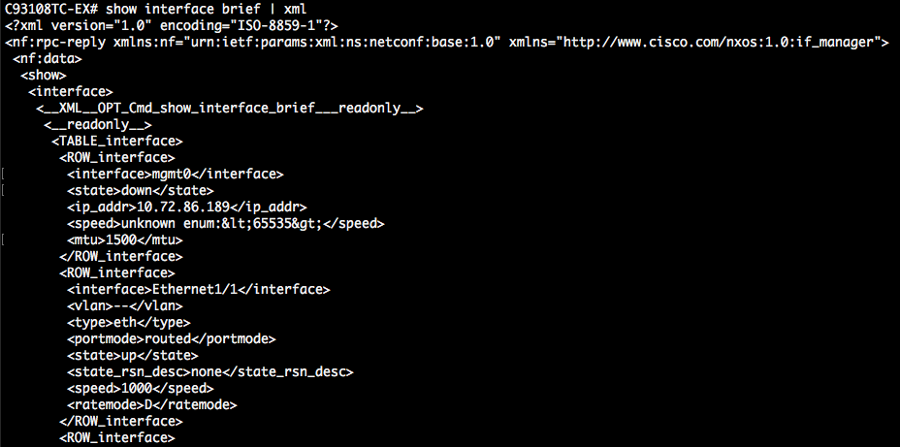
How to get NETCONF content (1/3) ?
# CLI show-command | xml

Slide 41
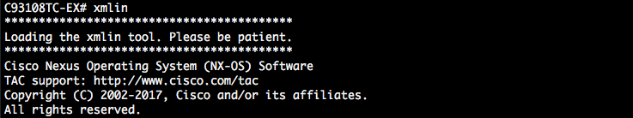
How to get NETCONF content (1/3)
# prepare for configuration cli command

Slide 42
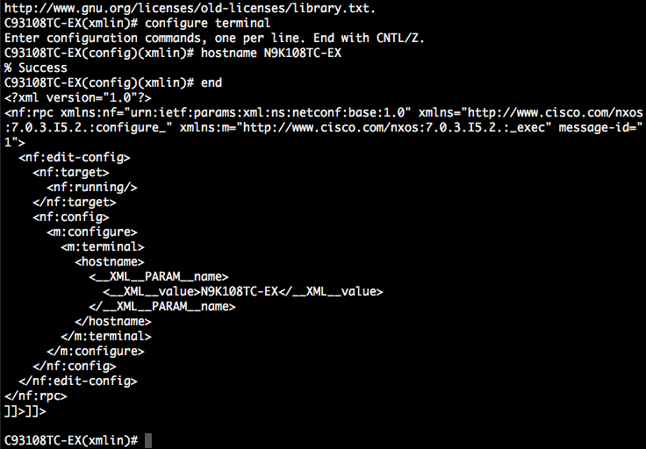
How to get NETCONF content (3/3) ?
# command for changing name of this switch
# payload of netconf

Slide 43
NETCONF Review
Notes:
With our solid understanding of the key elements of NETCONF, let's walk through the process a developer will take when using it.
Using a NETCONF Manager, connect to the Agent on a device and say <hello>
The Agent replies with a list of <capabilities>
The developer investigates the available data models provided as capabilities and selects the one that best meets their need.
Compose the XML data that will be sent using an avaialble operation (ex: <get-config>)
Send the message as a Remote Procedure Call <rpc> from the Manager
The Agent sends an <rcp-reply> back
Process the <data> that was included in the reply.
Also, by leveraging tools like ncclient for Python, the developer can focus more on their application elements, than the intricacies of the protocol.

Slide 44
Introduction to RESTCONF

Slide 45
RESTCONF Details
“an HTTP-based protocol that provides a programmatic interface for accessing data defined in YANG…”
RFC 8040 - January 2017
Uses HTTP(S) for transport
Tightly coupled to the YANG data model definitions
Provides JSON or XML data formats
https://tools.ietf.org/html/rfc8040

Slide 46
What about NETCONF?
Notes:
RESTCONF is NOT a replacement for NETCONF. RESTCONF provides an API that aligns with other Web Application APIs to provide an easy entry point for developers. Though the gaps maybe eventually be filled, today RESTCONF lacks complete feature parity with NETCONF.
More likely we will see both NETCONF and RESTCONF leveraged sumulataneiously by different clients.

Slide 47
RESTCONF Protocol Stack & Transport
Notes:
Transport - HTTP
Like other REST APIs, RESTCONF leverages the HTTP protocol to encapsulate and send messages. Authentication is accomplished using typical HTTP Authentication models such as Basic Authentication where usernames and passwords are encoded in BASE64 and transmitted in a Header.

Slide 48
Operations - HTTP CRUD
RESTCONF | NETCONF
GET | <get> , <get-config>
POST | <edit-config> (operation="create")
PUT | <edit-config> (operation="create/replace")
PATCH | <edit-config> (operation="merge")
DELETE | <edit-config> (operation="delete")
Notes:
REST APIs typically implement CRUD (Create, Retrieve, Update, and Delete) operations leveraging HTTP available methods. RESTCONF maps the NETCONF operations into these HTTP methods as shown in this table.

Slide 49
Content - XML or JSON
HTTP Headers
Content-Type: Specify the type of data being sent from the client
Accept: Specify the type of data being requested by the client
RESTCONF MIME Types
application/vnd.yang.data+json
application/vnd.yang.data+xml
Notes:
One of the major advantages RESTCONF has over NETCONF is it's ability to leverage JSON as a data format. Many developers prefer JSON over XML due to easier readability and lower overhead.
When crafting a RESTCONF request, you must specify the data format being sent, and requested by the Agent. This is done in the typical HTTP way, using request headers.
Content-Type: Specify the type of data being sent from the client
Accept: Specify the type of data being requested by the client
RESTCONF describes the following MIME types to be used in these headers to indicate the format being requested.
application/vnd.yang.data+json
application/vnd.yang.data+xml

Slide 50
Constructing RESTCONF URIs
https://<ADDRESS>/<ROOT>/<DATA STORE>/<[YANG MODULE:]CONTAINER>/<LEAF>[?<OPTIONS>]
ADDRESS - Of the RESTCONF Agent
ROOT - The main entry point for RESTCONF requests.
DATA STORE - The data store being queried
[YANG MODULE:]CONTAINER - The base model container being used
LEAF - An individual element from within the container
[?<OPTIONS>] - optional parameters that impact returned results.
Notes:
One aspect true of all REST APIs is the importance of the URI in identifying the data being requested or configured, and RESTCONF is no exception. One thing unique about RESTCONF is that it lacks any true "API Documentation" that a developer would use to learn about leveraging it. Rather, the YANG Models themselves ARE the API documentation.
All RESTCONF URIs follow this format:
ADDRESS - The IP (or DNS Name) and Port where the RESTCONF Agent is available
ROOT - The main entry point for RESTCONF requests.
Before connecting to a RESTCONF server, you must determine the root
Per the RESTCONF standard, devices should expose a resources called /.well-known/host-meta to enable discovery of root programmaticly
However with many devices still operating on DRAFT RESTCONF specs, this may not be fully implemented.
Device documentation should also specify the root path
On the Cisco CSR, this is api
DATA STORE - The data store being queried
[YANG MODULE:]CONTAINER - The base model container being used
Inclusion of the module name is optional
LEAF - An individual element from within the container
[?<OPTIONS>] - Some network devices may support options sent as query parameters that impact returned results.
These options are NOT required and can be omitted
Check device documentation for details on supported parameters
To make the RESTCONF calls, you can use any client application that supports any REST call. A common tool is the Chrome Application Postman. The Linux command line utility "curl" is another great tool for working with REST APIs. We'll show how to use both in these examples.

Slide 51
URL Creation Review
Key:
https://<ADDRESS>/<ROOT>/<DATA STORE>/<[YANG MODULE:]CONTAINER>/<LEAF>[?<OPTIONS>]
http://192.168.27.218:8008/api/running/interfaces/interface/GigabitEthernet2?deep
module: ietf-interfaces
+--rw interfaces
| +--rw interface* [name]
| +--rw name string
| +--rw description? string
| +--rw type identityref
| +--rw enabled? boolean
| +--rw link-up-down-trap-enable? enumeration {if-mib}?
Example edited for simplicity and brevity
Notes:
In this first example we're going to use RESTCONF to investigate the same ietf-interfaces model we've used in the previous labs.
As we learned, the URI is determined by looking at the underlying YANG model. Here is a partial ietf-interfaces Model.
This can be created by pyang -f tree ietf-interfaces.yang

Slide 52
curl command Review
Authentication
$ curl -u admin:C1sco12345 \
-H "Accept: application/vnd.yang.data+json" \
http://198.18.133.218:8008/api/running/interfaces/interface/GigabitEthernet2?deep
Header to specify JSON
URL
Example edited for simplicity and brevity
Notes:
The Linux command line utility "curl" is a great tool for working with REST APIs.
-H "Accept: application/vnd.yang.data+json" sets the HTTP "Accept" header to indicate our preference for JSON data
-u admin:C1sco12345 provides the credentials for the device

Slide 53
curl output Review
{
"ietf-interfaces:interface": {
"name": "GigabitEthernet1",
"type": "ianaift:ethernetCsmacd",
"enabled": true,
"cisco-ethernet:ethernet": {
},
"cisco-pw:pw-neighbor": {
"load-balance": {
}
},
"ietf-ip:ipv4": {
"address": [
{
"ip": "198.18.133.212",
"netmask": "255.255.192.0"
}
]
},
"ietf-ip:ipv6": {
"ietf-ipv6-unicast-routing:ipv6-router-advertisements": {
}
}
}
}
Leaf
interface
list
ipv4
Example edited for simplicity and brevity
Notes:
JSON Output from curl command.
Notice how the underlying YANG Model is represented in the output.

Slide 54
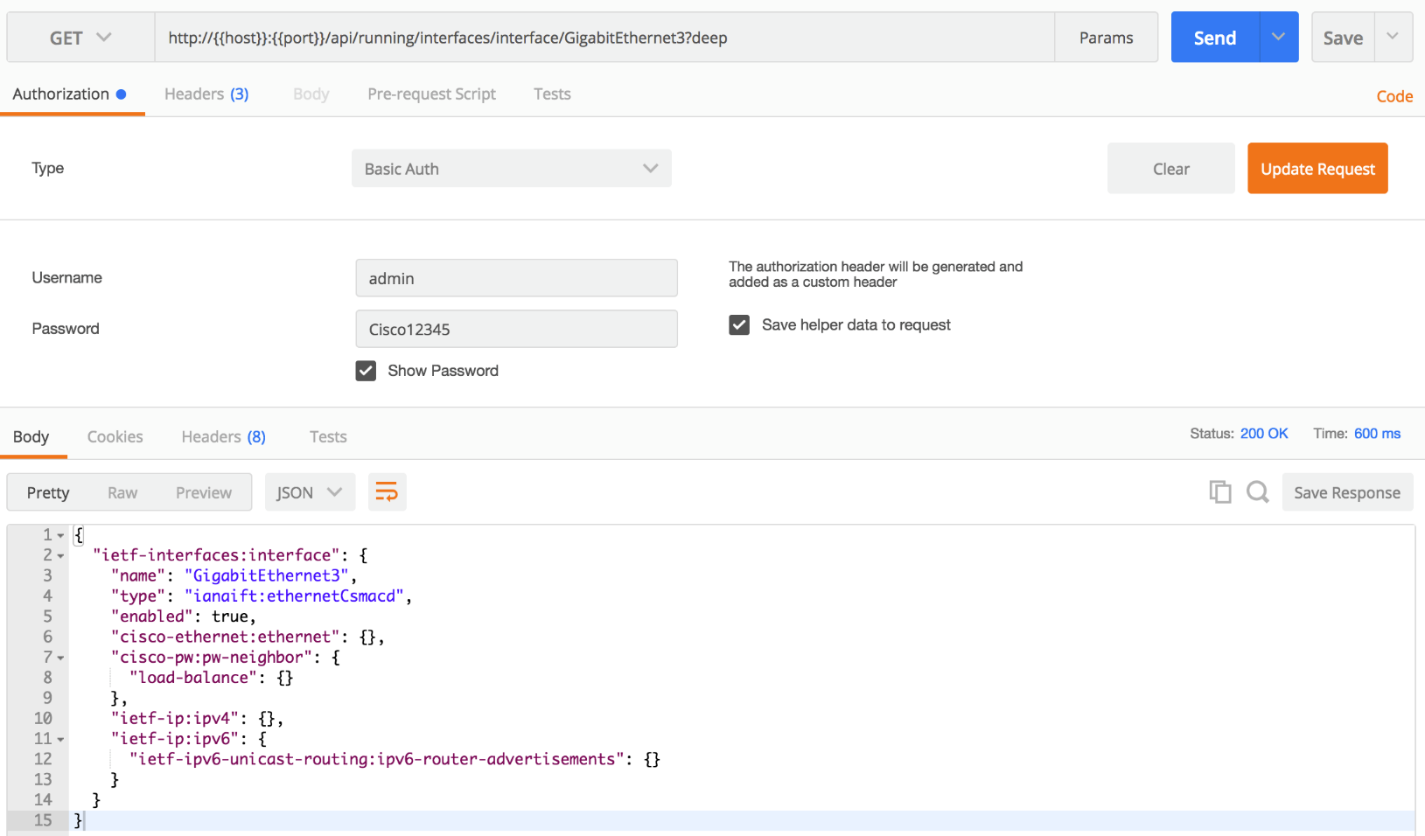
Postman Client Review
METHODS
URL
Set Headers
Authentication
HTTP Status Code
Returned Data
Notes:
Let’s review the key elements of working with POSTMAN
Provide the URL of the API call you are looking to make
Indicate the HTTP Method being used
Input any HEADERS needed. RESTCONF requries setting the Content-Type: and Accept: Headers to the proper MIME type
Provide the Authentication Information
Review the returned data
And verify the Status Code matches expectations

Slide 55
Useful Information

Slide 56
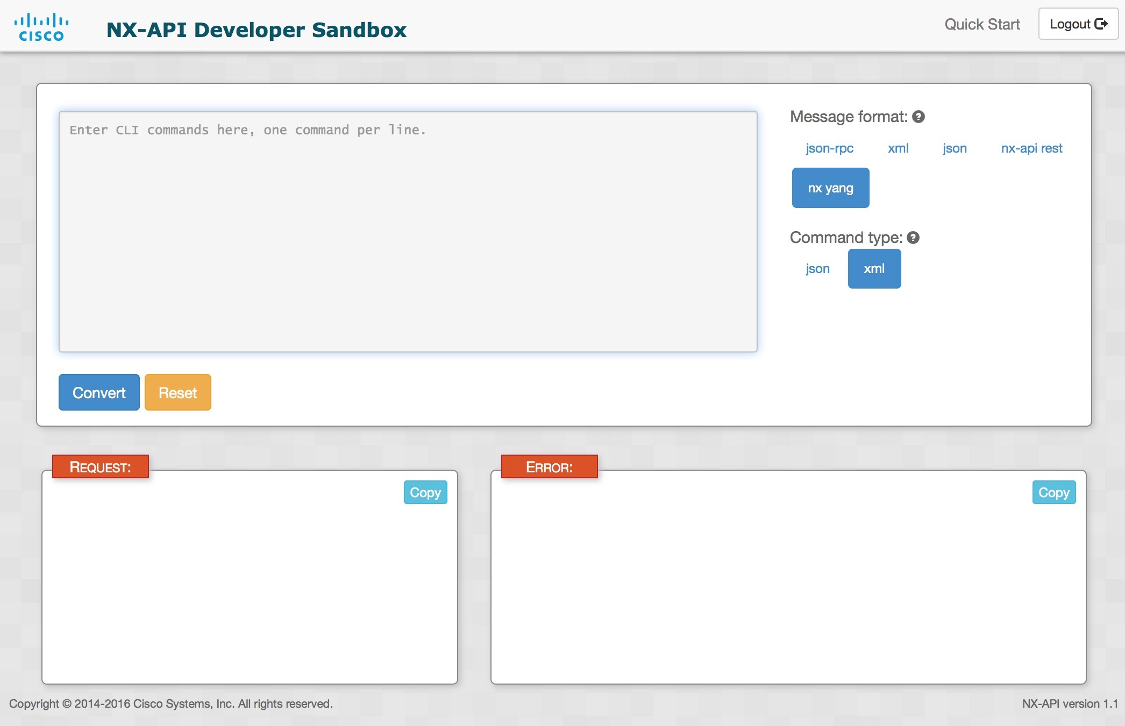
Where to get information
Cisco DevNet
  https://developer.cisco.com
Open NXOS SDK
  https://github.com/CiscoDevNet/NX-SDK
Open NXOS Sandbox
  https://devnetsandbox.cisco.com
NX-OSv 9000 Guide
  https://www.cisco.com/c/en/us/td/docs/switches/datacenter/nexus9000/sw/7-x/nx-osv/configuration/guide/b_NX-OSv_9000/b_NX-OSv_chapter_01.html
NX-API Developer Sandbox
  https://open-nxos-ip/

